Slide 1
Query Processing

Slide 2
Query Processing
Overview
Measures of Query Cost
Selection Operation
Sorting
Join Operation
Other Operations
Evaluation of Expressions

Slide 3
Basic Steps in Query Processing
1. Parsing and translation
2. Optimization
3. Evaluation

Slide 4
Basic Steps in Query Processing (Cont.)
Parsing and translation
translate the query into its internal form. This is then translated into relational algebra.
Parser checks syntax, verifies relations
Evaluation
The query-execution engine takes a query-evaluation plan, executes that plan, and returns the answers to the query.

Slide 5
Basic Steps in Query Processing: Optimization
EQUIVALENT OF EXPRESSION?
Given schema
instructor (id, name, dept-name, salary)
Query: Write relational algebra expression to find id and salary of all instructors whose id is less than 50501.
SQL: SELECT id, salary FROM INSTRUCTOR WHERE id<50501
Answer 1: σ_{id<50501}(∏_{id, salary}(instructor))
equivalent to
Answer 2: ∏_{id, salary}(σ_{id<50501}(instructor))
Discussion 1: Instructor is stored physically sorted order of id. Will the query processing cost of answer 1 and answer 2 be the same? How?

Slide 6
Basic Steps in Query Processing: Optimization
Each relational algebra operation can be evaluated using one of several different algorithms
Correspondingly, a relational-algebra expression can be evaluated in many ways.
Annotated expression specifying detailed evaluation strategy is called an evaluation-plan. E.g.,:
Use an index on id to find instructors with id < 50501 (Answer 2),
Or perform complete relation scan and discard instructors with id < 50501 (Answer 1)

Slide 7
Basic Steps: Optimization (Cont.)
Query Optimization: Amongst all equivalent evaluation plans choose the one with lowest cost.
Cost is estimated using statistical information from the database catalog
e.g.. number of tuples in each relation, size of tuples, etc.
In this chapter we shall study
How to measure query costs
Algorithms for evaluating relational algebra operations
How to combine algorithms for individual operations in order to evaluate a complete expression

Slide 8
Measures of Query Cost
Many factors contribute to time cost
disk access, CPU, and network communication
Cost can be measured based on
response time, i.e. total elapsed time for answering query, or
total resource consumption
We use total resource consumption as cost metric
Response time harder to estimate, and minimizing resource consumption is a good idea in a shared database
We ignore CPU costs for simplicity
Real systems do take CPU cost into account
Network costs must be considered for parallel systems
We describe how to estimate the cost of each operation
We do not include cost to writing output to disk

Slide 9
Measures of Query Cost
Disk cost can be estimated as:
Number of seeks * average-seek-cost
Number of blocks read * average-block-read-cost
Number of blocks written * average-block-write-cost
What is number of seeks?
Answer: The number of times, the disk head directly moves from one track to another track.
What is number of block reads?
Answer: The number of blocks need to be transferred from disk to memory to process the query.
What is number of blocks written?
Answer: The number of blocks need to be written to disk from memory to process the query.

Slide 10
Measures of Query Cost
For simplicity we just use the number of block transfers from disk and the number of seeks as the cost measures
t_{T} – time to transfer one block
Assuming for simplicity that write cost is same as read cost
t_{S} – time for one seek
Cost for b block transfers plus S seeks b * t_{T} + S * t_{S}
t_{S} and t_{T} depend on where data is stored; with 4 KB blocks:
High end magnetic disk: t_{S} = 4 msec and t_{T} =0.1 msec
SSD: t_{S} = 20-90 microsec and t_{T} = 2-10 microsec for 4KB

Slide 11
Selection Operation (σ)
File scan
Algorithm A1 (linear search). Scan each file block and test all records to see whether they satisfy the selection condition.
Example: The size of the given student relation is 2000 blocks. The seek time is 5ms and block transfer time is 0.1 ms. Find the estimated query cost for the following query
SELECT * FROM STUDENT WHERE cgpa > 3.5 or name = ‘Rafique’
Given student(id, name, CGPA, street, city)
Answer: The query requires 1 seek and full file scan to find all students with cgpa > 3.5. So b_{r} = 2000
Total cost = 1 × 5 + 2000 × 0.1 = 5 + 200 = 205ms
For full scan, cost estimate = 1 seek + b_{r} block transfers
b_{r} denotes number of blocks containing records from relation r

Slide 12
Selection Operation (σ)
File scan
Algorithm A1 (linear search). Scan each file block and test all records to see whether they satisfy the selection condition.
Question 15-1: The size of the given student relation is 2000 blocks. The seek time is 5ms and block transfer time is 0.1 ms. Find the estimated query cost for the following query
SELECT * FROM STUDENT WHERE id <1801111042
The student relation is physically sorted on id. The number of blocks with id <1801111042 is 800.
For partial scan, cost estimate (average) = 1 seek + (b_{r} /2) block transfers
Linear search can be applied regardless of selection condition or ordering of records in the file, or availability of indices

Slide 13
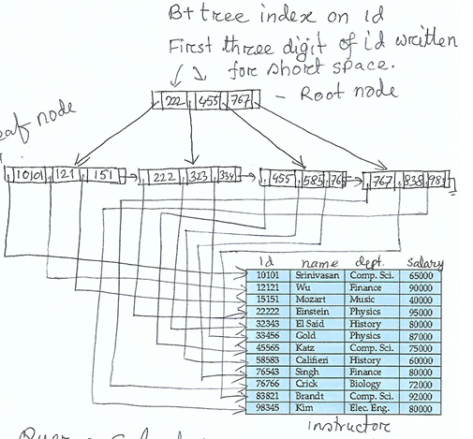
Selections Using Indices
Index scan – search algorithms that use an index
selection condition must be on search-key of index.
Question: Given the relation
Instructor (id, name, dept, salary)
Seek cost = 4ms, block cost = 0.1ms
Find the cost of query:
SELECT *
FROM INSTRUCTOR
WHERE id = 83821
Query cost = cost of index and cost of data
Index cost = root cost (1 block + 1 seek) + leaf cost (1 block + 1 seek)
= 2 blocks + 2 seeks
Data cost = 1 block + 1 seek
Total cost = 3 blocks + 3 seeks = 3*0.1 + 3*4 = 12.3 ms

Slide 14
Selections Using Indices
Index scan – search algorithms that use an index
selection condition must be on search-key of index.
Given the SQL
SELECT * FROM STUDENT WHERE id = 1520303042
Clustering B+ tree index on id
Example: How many records will be returned? Given the height of the index B+ tree is h_{i} , find the cost of the query.
A2 (clustering index, equality on key). Retrieve a single record that satisfies the corresponding equality condition
Cost = cost of index traversal + cost of data block
= h_{i} * (t_{S} + t_{T}) + (t_{S} + t_{T})

Slide 15
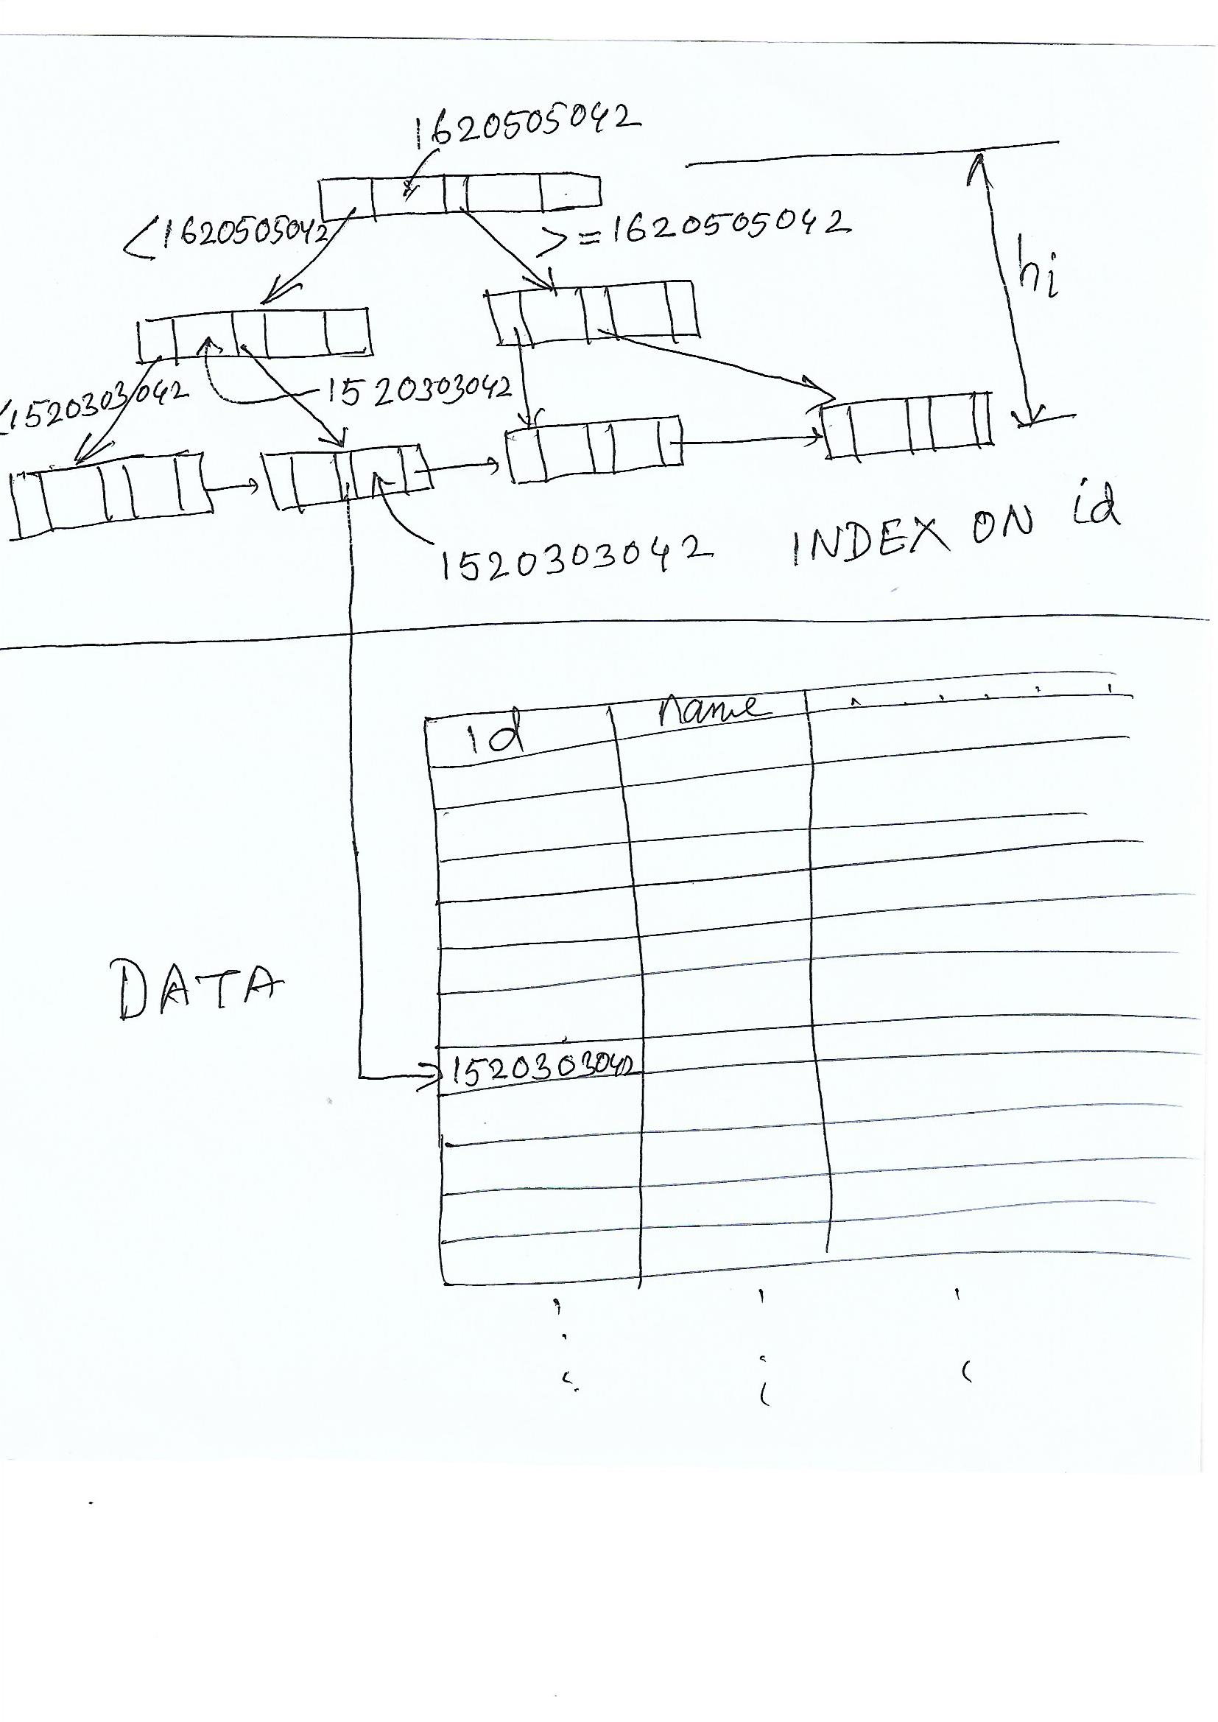
Index Search
Each node in different location in disk
Total Number of seek = h_{i} ,
Total number of block transfer = h_{i}
Estimated time = h_{i} * T_{S} + hi*T_{T}
Data Search
Total number of seek = 1,
Total number of block transfer = 1
Estimated time = T_{S} +T_{T}
Index and Data Search
Total Estimated time
= (h_{i} * T_{S} + hi*T_{T} )+ (T_{S} +T_{T} )

Slide 16
Selections Using Indices
A3 (clustering index, equality on nonkey) Retrieve multiple records.
Records will be on consecutive blocks
Let b = number of blocks containing matching records
Cost = h_{i} * (t_{T} + t_{S}) + t_{S} + t_{T} * b
Example: The relation student(id, name, CGPA, street, city, NID) is given. There is a clustering B+ tree index on city attribute of student relation and there are 200 cities. The height of the index is 2 and there are 400 students living in Uttara city. The record size is 400 byte and block size is 4KB.
Find the query cost for the following query
SELECT * FROM STUDENT WHERE CITY = ‘UTTARA’

Slide 17
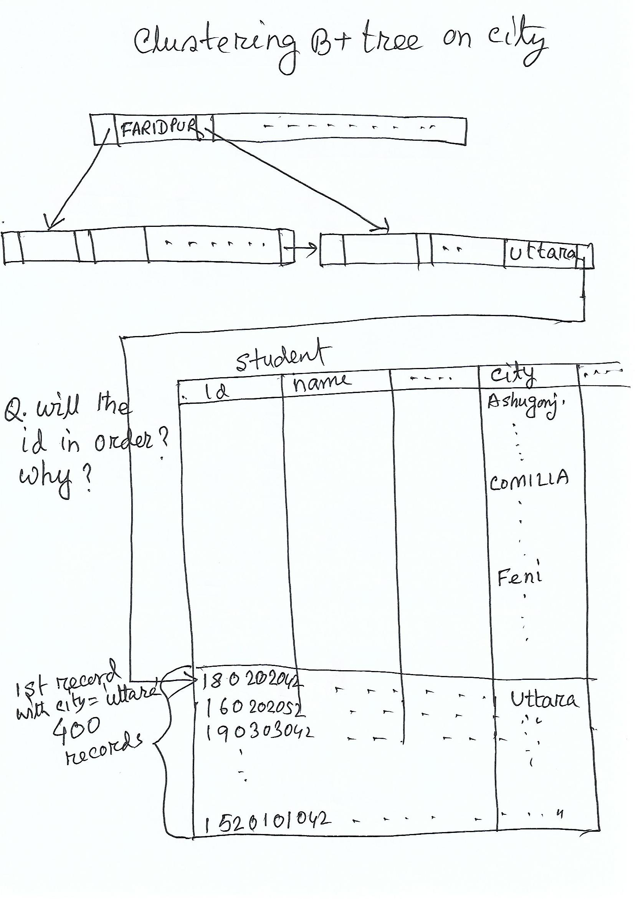
Selections Using Indices
Example: The relation student(id, name, CGPA, street, city, NID) is given. There is a clustering B+ tree index on city attribute of student relation and there are 200 cities. The height of the index is 2 and there are 400 students living in Uttara city. The record size is 400 byte and block size is 4KB.
Seek time = 10ms, block transfer time = 0.2ms
Find the query cost for the following query
SELECT * FROM STUDENT WHERE CITY = ‘UTTARA’

Slide 18
Selections Using Indices
Total cost =
Index cost + data cost
= 2 * (10+0.2) + 1 * 10 + 40 * 0.2
= 20.4 + 10+ 8
=

Slide 19
Selections Using Indices
A3 (clustering index, equality on nonkey) Retrieve multiple records.
Records will be on consecutive blocks
Let b = number of blocks containing matching records
Cost = h_{i} * (t_{T} + t_{S}) + t_{S} + t_{T} * b
Question 15-2: The relation student(id, name, CGPA, street, city, NID) is given. There is a clustering B+ tree index on name attribute of student relation and there are 2000 unique names. The height of the index is 4 and there are 20 students whose name is Abdullah. The record size is 400 bytes and block size is 4KB. Seek time = 10ms, block transfer time = 0.2ms
Find the query cost for the following query
SELECT * FROM STUDENT WHERE name = ‘Abdullah’

Slide 20
Selections Using Indices
A4 (secondary index, equality on key/non-key).
Retrieve a single record if the search-key is a candidate key
Cost = (h_{i} + 1) * (t_{T} + t_{S})
Retrieve multiple records if search-key is not a candidate key
each of n matching records may be on a different block
Cost = (h_{i} + n) * (t_{T} + t_{S}), Can be very expensive!
What is secondary index?
Student relation is physically sorted order in disk on id. There is an index on id.
What type of index on id? Why?
Answer: This is primary index because the file is sorted with the same attribute (id) as the index (id).
Other than the primary index of a relation, all indices of the relation are the secondary index.
There is an index on district attribute. What type of index is it?
Notes:
20

Slide 21
Selections Using Indices
A4 (secondary index, equality on key/non-key).
Retrieve a single record if the search-key is a candidate key
Cost = (h_{i} + 1) * (t_{T} + t_{S})
Example: There is a B+ tree index on NID attribute of student relation. The height of the index is 4. Seek cost is 10ms and block transfer cost is 0.2 ms.
Q1. Find the query cost for the following query using the above index.
SELECT * FROM student WHERE NID = 999888331
Q2: Find the query cost for the above query without using the index. Total number of blocks of student relation is 2000. The NID 999888331 is in 500th block.
Notes:
21

Slide 22
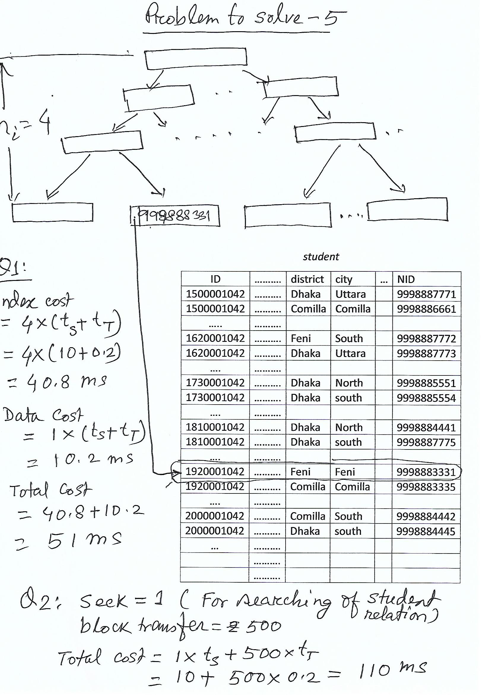
Selections Using Indices
Example: Given B+ tree index on NID attribute of student relation. The height of the index is 4. Seek cost is 10ms and block transfer cost is 0.2 ms.
Q1. Find the query cost for the following query using the above index.
SELECT * FROM student WHERE NID = 999888331
Q2. Find the query cost for the above query without using the index. Total number of blocks of student relation is 2000. The NID 999888331 is in 500th block.
Notes:
22

Slide 23
Selections Using Indices
A4 (secondary index, equality on key/non-key).
Retrieve multiple records if search-key is not a candidate key
each of n matching records may be on a different block
Cost = (h_{i} + n) * (t_{T} + t_{S}), Can be very expensive!
Example Given B+ tree index on district attribute of student relation and there are 64 districts. The height of the index is 1 and there are 800 students from Comilla. Each of the records is in different block. Seek cost is 10ms and block transfer cost is 0.2 ms.
Q1: Find the query cost for the following query
SELECT * FROM student WHERE district = ‘Comilla’
Q2: Find the query cost without using the index. (This requires full scan of the relation. Why?)
Notes:
23

Slide 24
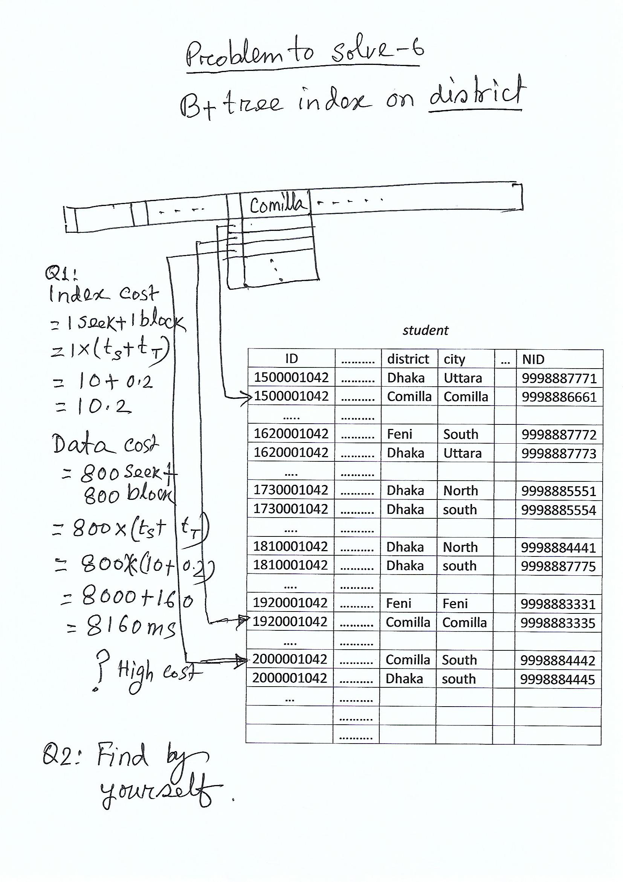
Selections Using Indices
Example Given B+ tree index on district attribute of student relation and there are 64 districts. The height of the index is 1 and there are 800 students from Comilla. Each of the records is in different block. Seek cost is 10ms and block transfer cost is 0.2 ms.
Q1: Find the query cost for the following query using the index.
SELECT * FROM student WHERE district = ‘Comilla’
Q2: Find the query cost without using the index. (This requires full scan of the relation. Why?)
Notes:
24

Slide 25
Selections Using Indices
Question 16-1 Given B+ tree index on city attribute of student relation and there are 500 cities. The height of the index is 2 and there are 30 students from city Bhola. Each of the records is in different block and no block is consecutive. Seek cost is 10ms and block transfer cost is 0.1 ms. The number of blocks of student relation is 2000.
a. Find the query cost for the following query using the index.
SELECT * FROM student WHERE city = ‘Bhola’
b. Find the query cost without using the index.
c. Find cost of a if Bhola would have 5 students.
d. Compare and explain the cost of a, b and c
Notes:
25

Slide 26
Selections Involving Comparisons
Can implement selections of the form σ_{A≤V} (r) or σ_{A ≥ V}(r) by using
a linear file scan,
or by using indices in the following ways:
A5 (clustering index, comparison). (Relation is sorted on A)
For σ_{A ≥ V}(r) use index to find first tuple ≥ v and scan relation sequentially from there
For σ_{A≤V} (r) just scan relation sequentially till first tuple > v; do not use index
Example: Given clustering index on id of student relation.
Q1. Find all students with id <= 1500001042. The id 1500001042 is the first tuple of student relation.
SELECT * FROM student WHERE id <= 1500001042
Q2. Find all students with id <= 1800001042. The id 1800001042 is in 1200th block of student relation.
SELECT * FROM student WHERE id <= 1800001042
Find the query cost of Q1 and Q2. Here no need to use index (why?). Seek cost is 10ms and block transfer cost is 0.2 ms.

Slide 27
Selections Involving Comparisons
Example: Given clustering index on id of student relation.
Q1. Find all students with id <= 1500001042. The id 1500001042 is the first tuple of student relation.
SELECT * FROM student WHERE id <= 1500001042
Q2. Find all students with id <= 1800001042. The id 1800001042 is in 1200th block of student relation.
SELECT * FROM student WHERE id <= 1800001042
Find the query cost of Q1 and Q2. Here no need to use index (why?). Seek cost is 10ms and block transfer cost is 0.2 ms.
Answer of Example:
With Index ( No need to use index)
Cost without index
Q1 cost
= index cost + data cost
= 0 + 1 * (10+0.2)
= 10.2ms
Q2 cost
= index cost + data cost
= 0 + 1 seek * 10 + 1200block * 0.2
=10 + 240
=250ms

Slide 28
Selections Involving Comparisons
Example: Given clustering index on id of student relation.
Q3. Find all students with id > 1800001042. The id 1800001042 is in 1200th block of student relation.
SELECT * FROM student WHERE id > 1800001042
Find the query cost of Q3 with index. The height of the index is 4. Seek cost is 10ms and block transfer cost is 0.2 ms.
Answer of Example:
With Index
Query cost
= index cost + data cost
= 4 * (10+0.2) + 10+
(2000 – 1200) * (0.2)
= 50.8 + 160

Slide 29
Selections Involving Comparisons
A6 (Secondary index, comparison).
For σ_{A ≥ V}(r) use index to find first index entry ≥ v and scan index sequentially from there, to find pointers to records.
For instructor relation, 12 blocks for 12 records.
Select * from instructor where salary >= 60000
Asssume index in memory,
Query Cost = 11 seek + 11 blocks

Slide 30
Selections Involving Comparisons
A6 (Secondary index, comparison).
For σ_{A≤V} (r) just scan leaf pages of index finding pointers to records, till first entry > v
For instructor relation, 12 blocks for 12 records.
Select * from instructor where salary <= 87000
Data Cost = 9 seek + 9 blocks

Slide 31
Selections Involving Comparisons
A6 (Secondary index, comparison).
For σ_{A ≥ V}(r) use index to find first index entry ≥ v and scan index sequentially from there, to find pointers to records. Index in memory.
For instructor relation, 12 blocks for 12 records. Q1:Select * from instructor where salary >= 60000, Data Cost = 11 seek + 11 blocks, seek cost 10ms, block cost 0.1ms
For σ_{A≤V} (r) just scan leaf pages of index finding pointers to records, till first entry > v
Q2:Select * from instructor where salary <= 87000, Data Cost = 9 seek + 9 blocks
Example: In either case, retrieve records that are pointed to, requires an I/O per record; Linear file scan may be cheaper! (Explain?)

Slide 32
Implementation of Complex Selections (12-11-20)
What is conjunctive selection?
Selection that uses a combinations of predicates
Given schema
Student(id, name, fname, mname, cgpa, year-admit, division, district, thana, street, house-number, city, NID, DOB, total-credit)
Example: Find students with CGPA = 4 and city = Feni and year-admit = 2019
Conjunction: σ_{θ1}∧ _{θ2}∧. . . _{θn}(r)
A7 (conjunctive selection using one index).
Select a combination of θ_{i} and algorithms A1 through A7 that results in the least cost for σ_{θi} (r).
Test other conditions on tuple after fetching it into memory buffer.
A8 (conjunctive selection using composite index).
Use appropriate composite (multiple-key) index if available.
A9 (conjunctive selection by intersection of identifiers).
Requires indices with record pointers.
Use corresponding index for each condition, and take intersection of all the obtained sets of record pointers.
Then fetch records from file
Algebra:
σ_{CGPA=4}∧ _{city = Feni}∧ _{year-admit=2019}(student)
θ₁= (CGPA=4), θ₂= (City=‘Feni’),
θ₃= (year-admit=2019),

Slide 33
Implementation of Complex Selections
Example Given B+ tree indices on CGPA, city and year-admit. The height of the indices are 2, 2 and 1 respectively.
SQL: SELECT * FROM student WHERE CGPA=4 AND City=‘Feni’ AND year-admit=2019. t_{T} = 0.2ms, t_{S} = 10ms
The number of tuples (pointers) for CGPA=4, City=‘Feni’ AND year-admit=2019 are 5, 20 and 4000 respectively
Find the least cost of the SQL using A7 algorithm.
The indices are secondary index, We have to use A4 algorithm.
Query cost = index cost + data cost
= h_{i} * (t_{T} + t_{S}) + n * (t_{T} + t_{S})
Conjunction: σ_{θ1}∧ _{θ2}∧. . . _{θn}(r)
A7 (conjunctive selection using one index).
Select a combination of θ_{i} and algorithms A1 through A7 that results in the least cost for σ_{θi} (r).
Test other conditions on tuple after fetching it into memory buffer.
Example: Find students with CGPA = 4 and city = Feni and and year-admit = 2019
Algebra:
σ_{CGPA=4}∧ _{city = Feni}∧ _{year-admit=2019}(r)
θ₁= (CGPA=4), θ₂= (City=‘Feni’),
θ₃= (year-admit=2019),

Slide 34
Implementation of Complex Selections
Example Given B+ tree indices on CGPA, city and year-admit. The height of the indices are 2, 2 and 1 respectively.
SQL: SELECT * FROM student WHERE CGPA=4 AND City=‘Feni’ AND year-admit=2019. t_{T} = 0.2ms, t_{S} = 10ms
The number of tuples (pointers) for CGPA=4, City=‘Feni’ AND year-admit=2019 are 5, 20 and 4000 respectively
Find the least cost of the SQL using A7 algorithm and analyze the result.
The indices are secondary index, We have to use A4 algorithm.
Query cost = index cost + data cost
= h_{i} * (t_{T} + t_{S}) + n * (t_{T} + t_{S})
C1: Cost using CGPA index
n = 5,
cost = 2 * (10 + 0.2) + 5 * (10 + 0.2)
C2: Cost using city index
n = 20
cost = 2 * (10 + 0.2) + 20 * (10 + 0.2)
Cost using year-admit index
n = 4000
C3: cost = 2 * (10 + 0.2) + 4000 * (10 + 0.2)
Analysis:

Slide 35
Implementation of Complex Selections
Question 17-1 Given B+ tree indices on name, and total-credit. The height of the indices are 4 and 2 respectively.
SQL: SELECT * FROM student WHERE name=‘Abdullah’ AND total-credit = 100
t_{T} = 0.1ms, t_{S} = 10ms
The number of tuples (pointers) name=‘Abdullah’ AND total-credit = 100 are 50 and 200 respectively
a. Find the least cost of the SQL using A7 algorithm and analyze the result.
The indices are secondary index, We have to use A4 algorithm.
Query cost = index cost + data cost
= h_{i} * (t_{T} + t_{S}) + n * (t_{T} + t_{S})
b. Analyze the result

Slide 36
Implementation of Complex Selections
Given B+ tree composite index on (CGPA, city, year-admit).
Discussion 2: Explain how will this query be executed using composite index?
Conjunction: σ_{θ1}∧ _{θ2}∧. . . _{θn}(r)
A8 (conjunctive selection using composite index).
Use appropriate composite (multiple-key) index if available.
What is composite index?
Index on multiple attributes.
composite index on
(CGPA, city, year-admit)
Search keys in index:
(3, ‘Dhaka’, 2015) record
(3, ‘Dhaka’, 2017) record
(3, ‘Dhaka’, 2020) record
(3, ‘Feni’, 2015) record
(3, ‘Feni’, 2020) record
SELECT * FROM student WHERE CGPA=3 AND City=‘Feni’ AND year-admit=2015
Example: Find students with CGPA = 4 and city = Uttara and and year-admit = 2019
Algebra:
σ_{CGPA=4}∧ _{city = Feni}∧ _{year-admit=2019}(r)
θ₁= (CGPA=4), θ₂= (City=‘Feni’),
θ₃= (year-admit=2019),
SQL: SELECT * FROM student WHERE CGPA=4 AND City=‘Feni’ AND year-admit=2019

Slide 37
Implementation of Complex Selections
Given B+ tree composite index on (CGPA, city, year-admit).
Discussion 2: Explain how will this query be executed using composite index?
Conjunction: σ_{θ1}∧ _{θ2}∧. . . _{θn}(r)
A8 (conjunctive selection using composite index).
Use appropriate composite (multiple-key) index if available.
Example Find the cost of the SQL using A8 algorithm.
The height of the composite index is 4 and the number of tuples (pointers) for CGPA=4, City=‘Feni’ AND year-admit=2019 is 2.
The composite index is a secondary index.
Query cost = index cost + data cost
= h_{i} * (t_{T} + t_{S}) + n * (t_{T} + t_{S})
Analyze A7 and A8
Example: Find students with CGPA = 4 and city = Uttara and and year-admit = 2019
Algebra:
σ_{CGPA=4}∧ _{city = Feni}∧ _{year-admit=2019}(r)
θ₁= (CGPA=4), θ₂= (City=‘Feni’),
θ₃= (year-admit=2019),
SQL: SELECT * FROM student WHERE CGPA=4 AND City=‘Feni’ AND year-admit=2019

Slide 38
Implementation of Complex Selections
Given B+ tree indices on CGPA, city and year-admit.
Discussion 3: Explain how will this query be executed using algorithm A9?
Conjunction: σ_{θ1}∧ _{θ2}∧. . . _{θn}(r)
A9 (conjunctive selection by intersection of identifiers).
Requires indices with record pointers.
Use corresponding index for each condition, and take intersection of all the obtained sets of record pointers.
Then fetch records from file
Example: Find students with CGPA = 4 and city = Feni and and year-admit = 2019
Algebra:
σ_{CGPA=4}∧ _{city = Feni}∧ _{year-admit=2019}(r)
θ₁= (CGPA=4), θ₂= (City=‘Feni’),
θ₃= (year-admit=2019),
SQL: SELECT * FROM student WHERE CGPA=4 AND City=‘Feni’ AND year-admit=2019
Example: Find the cost of the SQL using A9 algorithm.
The height of the indices are 2, 2 and 1 respectively.
The number of tuples (pointers) for CGPA=4, City=‘Feni’ AND year-admit=2019 are 5, 20 and 4000 respectively
The indices are secondary index.

Slide 39
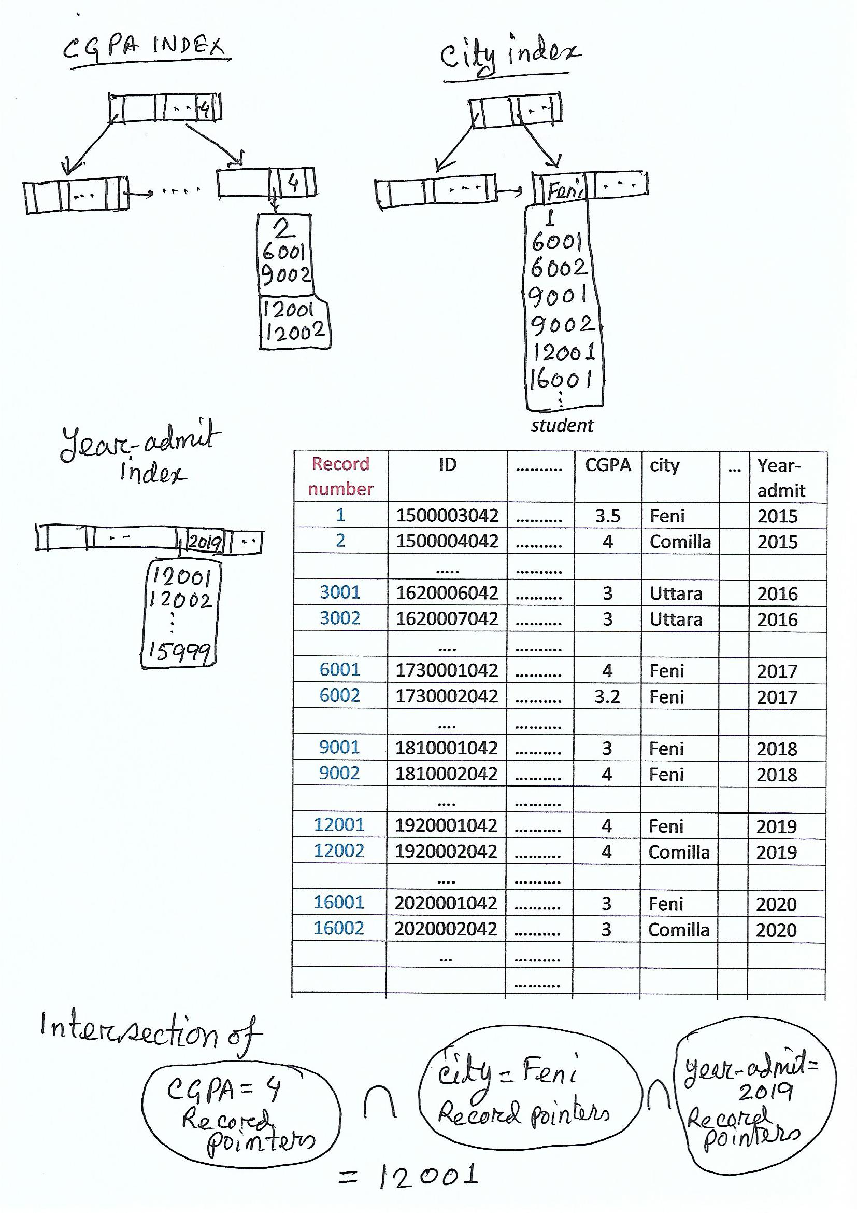
Given B+ tree indices on CGPA, city and year-admit.
Discussion 3: Explain how will this query be executed using algorithm A9?
Example Find the cost of the SQL using A9 algorithm.
The height of the indices are 2, 2 and 1 respectively.
The number of tuples (pointers) for CGPA=4, City=‘Feni’ AND year-admit=2019 are 5, 20 and 4000 respectively
The indices are secondary index.
Cost = Cost of (CGPA index + City index+year-admit index) + 1 data
= 2 * (t_{T} + t_{S}) + 2 * (t_{T} + t_{S}) +1 * (t_{T} + t_{S}) +1 * (t_{T} + t_{S})
= 61.2ms

Slide 40
Question 17-2 Given B+ tree indices on name, and total-credit. The height of the indices are 4 and 2 respectively.
SQL: SELECT * FROM student WHERE name=‘Abdullah’ AND total-credit = 100
t_{T} = 0.1ms, t_{S} = 10ms
The number of tuples (pointers) name=‘Abdullah’ AND total-credit = 100 are 50 and 200 respectively. The number of common pointers are 5 and each tuple is in different block.
a. Find the cost of the SQL using A9 algorithm.
The indices are secondary index
Query cost = index cost + data cost
Cost = Cost of (name index + total-credit index) + 5 data
b. Analyze the result

Slide 41
Algorithms for Complex Selections
Disjunctive Selection
SQL: SELECT * FROM student WHERE CGPA=4 OR City=‘Feni’ OR year-admit=2019
Given B+ tree indices on CGPA, city and year-admit.
Discussion 4: Explain how will this query be executed using algorithm A10?
Disjunction:σ_{θ1}∨ _{θ2} ∨. . . _{θn} (r).
A10 (disjunctive selection by union of identifiers).
Applicable if all conditions have available indices.
Otherwise use linear scan.
Use corresponding index for each condition, and take union of all the obtained sets of record pointers.
Then fetch records from file
Example: Find the cost of the SQL using A10 algorithm.
The height of the indices are 2, 2 and 1 respectively.
The number of tuples (pointers) for CGPA=4, City=‘Feni’ and year-admit=2019 are 5, 20 and 4000 respectively
The indices are secondary index.

Slide 42
Algorithms for Complex Selections
Example Find the cost of the SQL using A10 algorithm.
The height of the indices are 2, 2 and 1 respectively.
The number of tuples (pointers) for CGPA=4, City=‘Feni’ AND year-admit=2019 are 5, 20 and 4000 respectively
The indices are secondary index.
Disjunction:σ_{θ1}∨ _{θ2} ∨. . . _{θn} (r).
A10 (disjunctive selection by union of identifiers).
Applicable if all conditions have available indices.
Otherwise use linear scan.
Use corresponding index for each condition, and take union of all the obtained sets of record pointers.
Then fetch records from file
Cost = Cost of (CGPA index + City index+year-admit index) + ??? data
= 2 * (t_{T} + t_{S}) + 2 * (t_{T} + t_{S}) +1 * (t_{T} + t_{S}) +n(?) * (t_{T} + t_{S})
= 5*10.2 + n(?) *10.2

Slide 43
Example Find the cost of the SQL using A10 algorithm.
The height of the indices are 2, 2 and 1 respectively.
The number of tuples (pointers) for CGPA=4, City=‘Feni’ AND year-admit=2019 are 5, 20 and 4000 respectively
The indices are secondary index.
2
6001
9002
12001
12002
1
6001
6002
12001
16001
12001
12002
12003
……
15999
Cost = Cost of (CGPA index + City index+year-admit index) + ??? data
= 2 * (t_{T} + t_{S}) + 2 * (t_{T} + t_{S}) +1 * (t_{T} + t_{S}) +??? * (t_{T} + t_{S})
= 5*10.2 + n(?) *10.2
n = CGPA record set ∪ city record set ∪ year-admit record set
= 5 + 18 + 3998 = 4021

Slide 44
Question 18-1 Given B+ tree indices on name, and total-credit. Total number of blocks is 2000. The height of the indices are 4 and 3 respectively.
SQL: SELECT * FROM student WHERE name=‘Abdullah’ OR total-credit = 100
t_{T} = 0.1ms, t_{S} = 10ms
The number of tuples (pointers) name=‘Abdullah’ AND total-credit = 100 are 50 and 200 respectively. The number of common pointers are 5 and each tuple is in different block.
a. Find the cost of the SQL using A10 algorithm.
The indices are secondary index
Query cost = index cost + data cost
Cost = Cost of (name index + total-credit index) + n(?) data
b. Find the cost of the query using A1 algorithm
c. Analyze the result

Slide 45
Algorithms for Complex Selections
Negation: σ_{¬θ}(r)
Use linear scan on file
If very few records satisfy ¬θ, and an index is applicable to θ
Find satisfying records using index and fetch from file

